Slide 1
Progress Report Presentation
11/27/2023
Mohamed Ghonim, Hayden Galante, Alex Maso, Phanindra Vemireddy

Slide 2
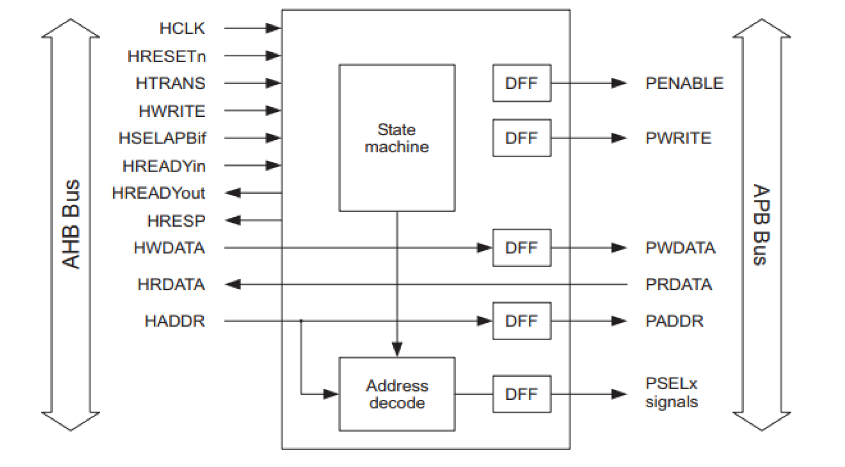
Project Proposal/Overview
We’re verifying the AHB to APB bridge using the AMBA specifications. We are basically writing an assertion IP (AIP) based on the AMBA ARM specs and testing/applying it on an RTL implementation from Github.

Slide 3
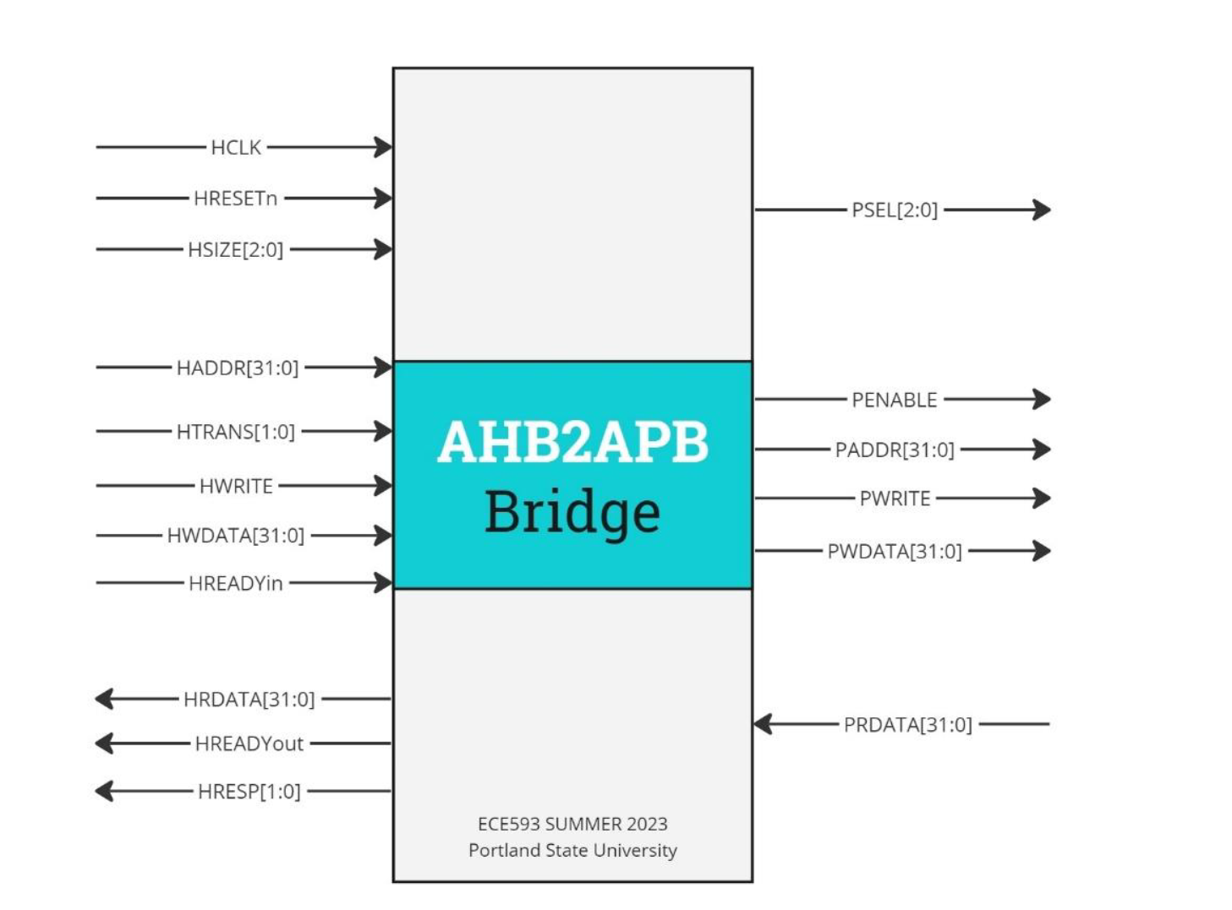
Bus Bridge Description
● AHB to APB bridge provides an interface between the high speed AHB and the low power APB.
● Read and write transfers on the AHB are converted into equivalent transfers on the APB.
● It has AHB slave bus interface, APB transfer state machine, which is independent of the device memory map, and APB output signal generation.
● It buffers address, controls, and data from the AHB, drives the APB peripherals and returns data along with a response signal to the AHB.
● APB data bus is divided into read (PRDATA), where data travels from the peripherals to the bridge and write (PWDATA), where data travels from the bridge to the peripherals.
● Data transfers can have 3 different sizes (HSIZE) Byte, halfword or full word.
● Data transfers are either sent as a single transfer or can be sent in a burst (HBURST). Bursts can be incremental or wrapping bursts with 4 or 8-beats.

Slide 4
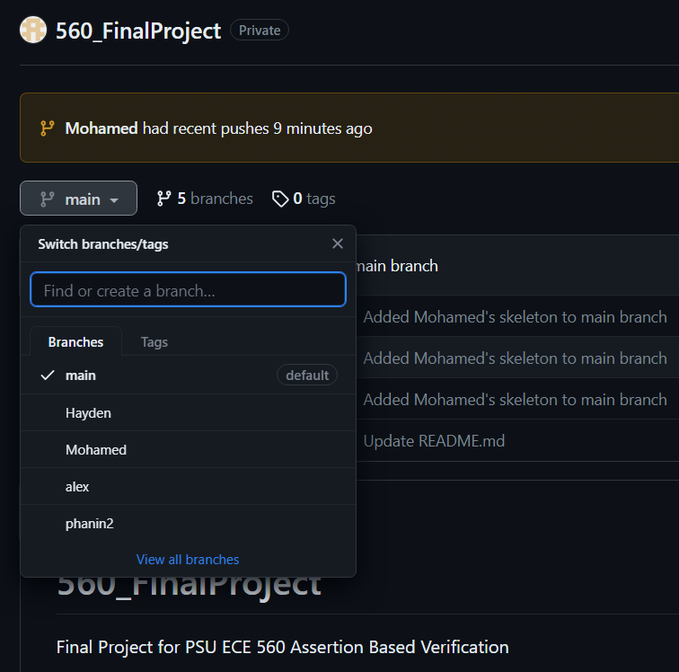
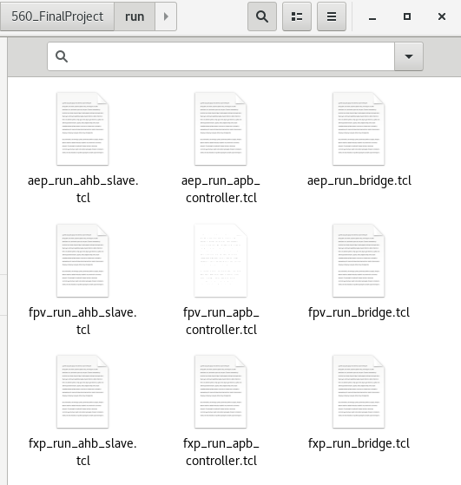
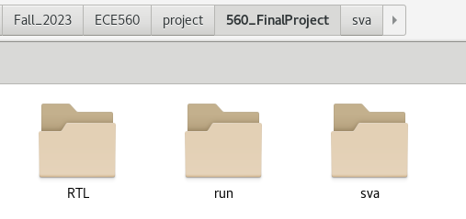
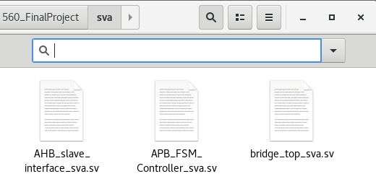
Project Collaboration and file Structure
We created a github repo with 4 branches, one for each team member
Initially, we “explored” the design
With the AEP and FXP apps

Slide 5
Input Port Signals
Input Port:
AHB:
● HCLK: Clock signal for the AHB interface.
● HRESETn: Active-low reset signal for the AHB interface.
● HSIZE[2:0]: Size of the transfer on the AHB interface.
● HADDR[31:0]: Address for the AHB transfer.
● HTRANS[1:0]: Transfer type on the AHB interface.
● HWRITE: Write enable signal for the AHB interface.
● HWDATA[31:0]: Write data on the AHB interface.
● HREADYin: Ready signal indicating the availability of the AHB interface.
APB:
● PRDATA[31:0]: Read data on the APB interface.

Slide 6
Output Port Signals
AHB:
● HRDATA[31:0]: Read data from the AHB interface.
● HREADYout: Ready signal indicating the readiness of the AHB interface.
● HRESP[1:0]: Response indicating the status of the AHB transfer.
APB:
● PSEL[2:0]: Slave select signal on the APB interface.
● PENABLE: Enable signal for the APB interface.
● PADDR[31:0]: Address for the APB transfer.
● PWRITE: Write enable signal for the APB interface.
● PWDATA[31:0]: Write data on the APB interface.

Slide 7
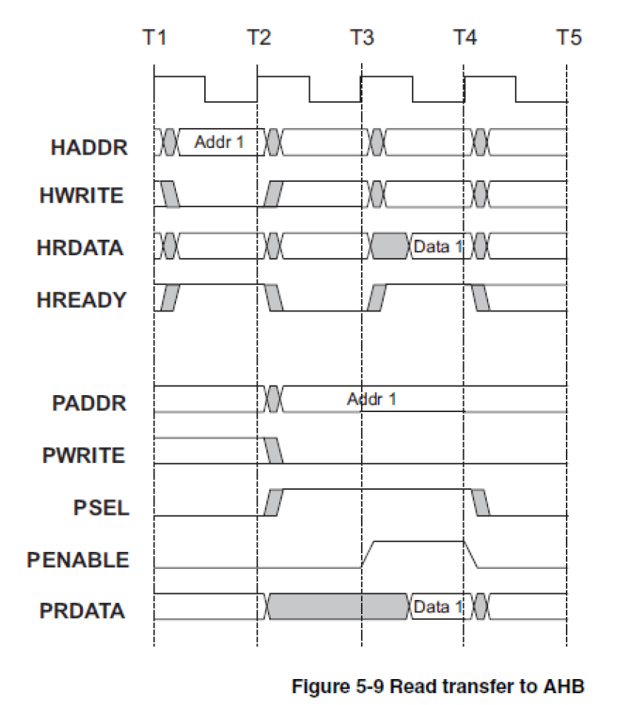
Read transfer to AHB
HWRITE - Low for Read
HREADY - AHB asserted with HWRITE then strobed once
PSEL - Asserted for two cycles along with PWRITE starting in T3 - Enter SETUP
PENABLE is asserted in T4, the cycle after PSEL is asserted - Enter ENABLE
The following cycle, T5, PSEL and PENABLE deasserted. - Single Read

Slide 8
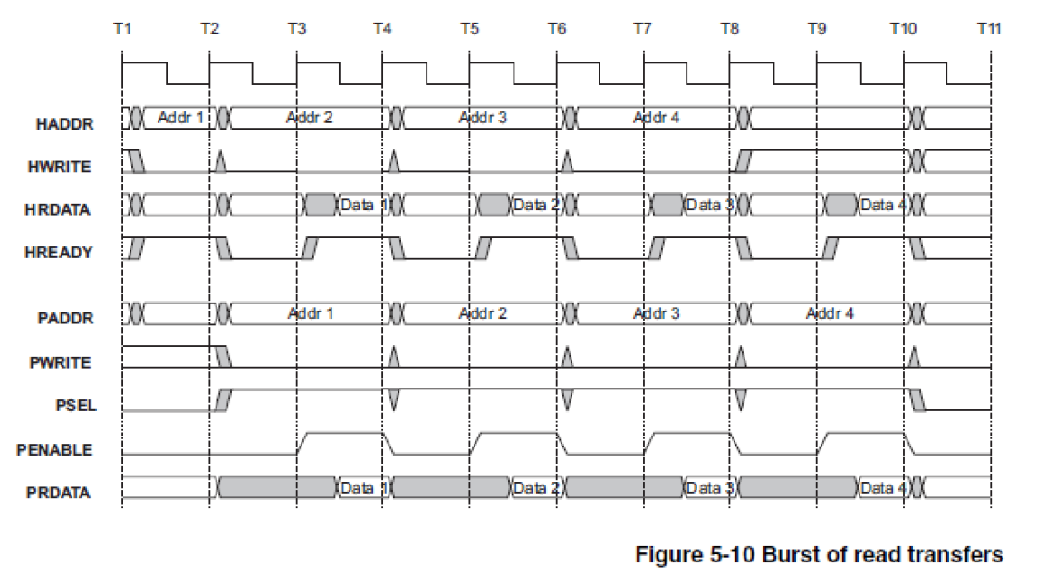
Burst of Read Transfers
HWRITE - Held low for Seq Read
HREADY - AHB asserted with HWRITE then strobed during burst
PSEL - Asserted along with PWRITE in T3 - Enter SETUP
PENABLE is asserted in T4, the cycle after PSEL is asserted - Enter ENABLE
The following cycle, T5, PENABLE deasserted. Strobed for burst
PSEL held high for burst

Slide 9
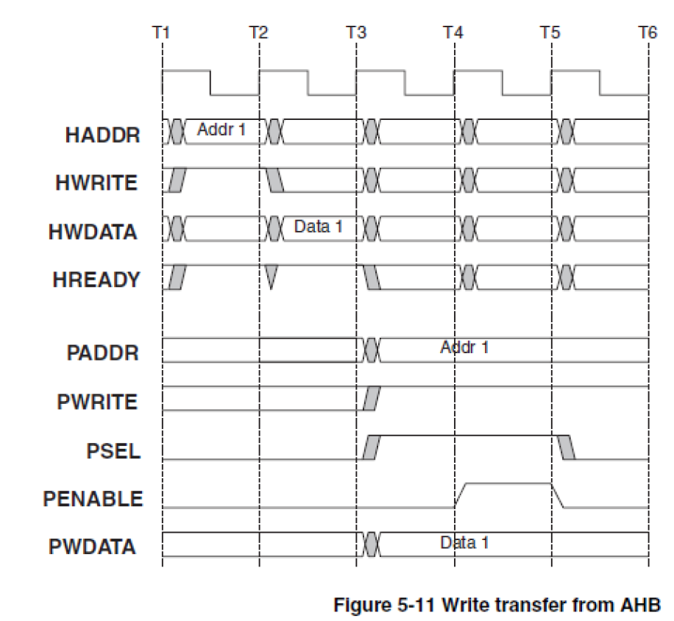
Write Transfer from AHB
HWRITE - High for Read
HREADY - AHB asserted for two cycles
PSEL - Asserted for two cycles along with PWRITE starting in T4 - Enter SETUP
PENABLE is asserted in T5, the cycle after PSEL is asserted Enter ENABLE
The following cycle, T6, PSEL and PENABLE deasserted. - Single Read

Slide 10
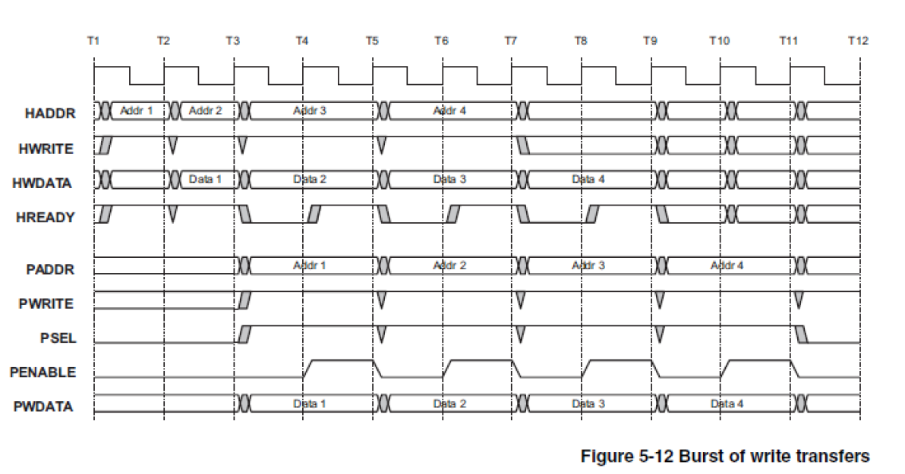
Burst of Write Transfers
HWRITE - Held high for Seq Read
HREADY - AHB asserted with HWRITE then strobed during burst
PWRITE - Low in T2, after AHB asserts HREADY
PSEL - Asserted along with PWRITE - Enter SETUP
PENABLE is asserted in T3, the cycle after PSEL is asserted - Enter ENABLE
The following cycle, T4, PENABLE deasserted. Cycles high and low for burst
PSEL held high for burst

Slide 11
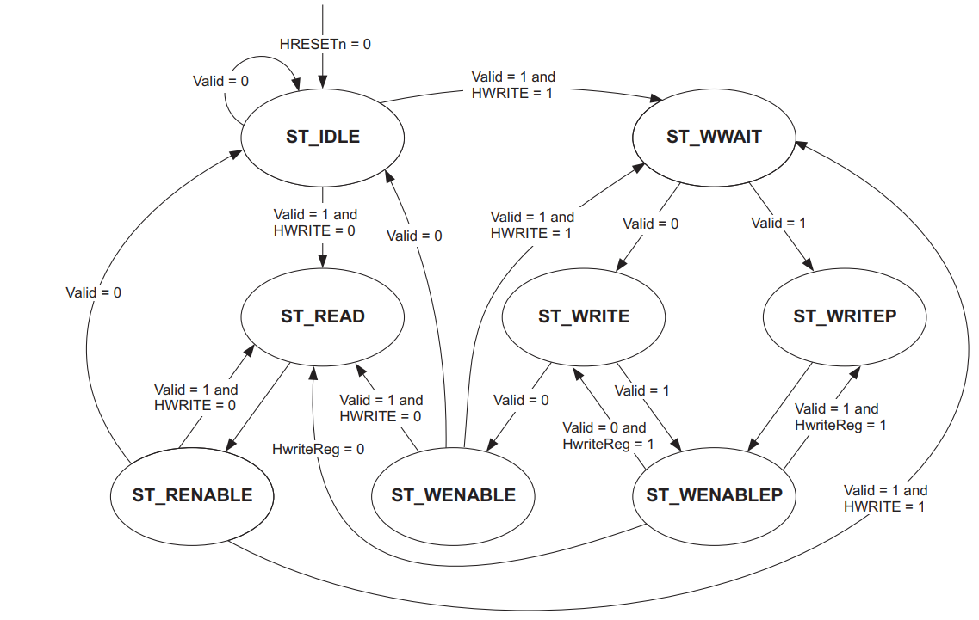
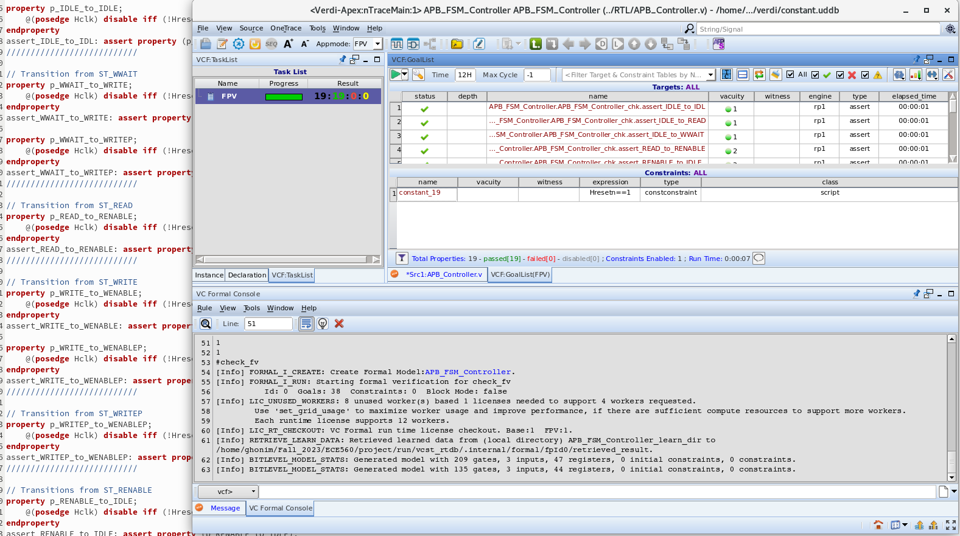
Verifying the State Machine for the AHB to APB interface
Wrote 19 assertions testing the 19 transitions in the FSM. They all passed.
FSM from the official AMBA Technical Reference

Slide 12
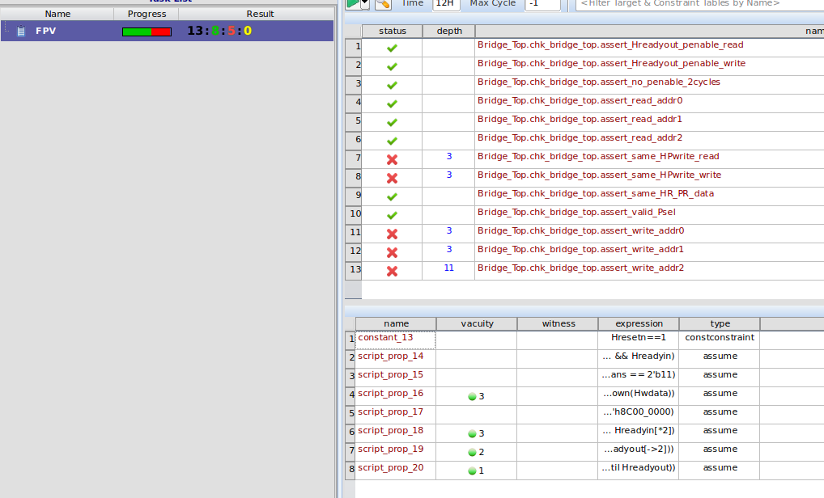
Verifying the Read and Write Transactions
Wrote multiple assertions to check validity for output signals like, PENABLE, PSEL, PWRITE, HRDATA
Wrote a new assumption for back to back reads after observing failing assertions for read transfers
Some of them are failing during the scenario of Read followed by Write
Need to update assertions for the falling scenario

Slide 13
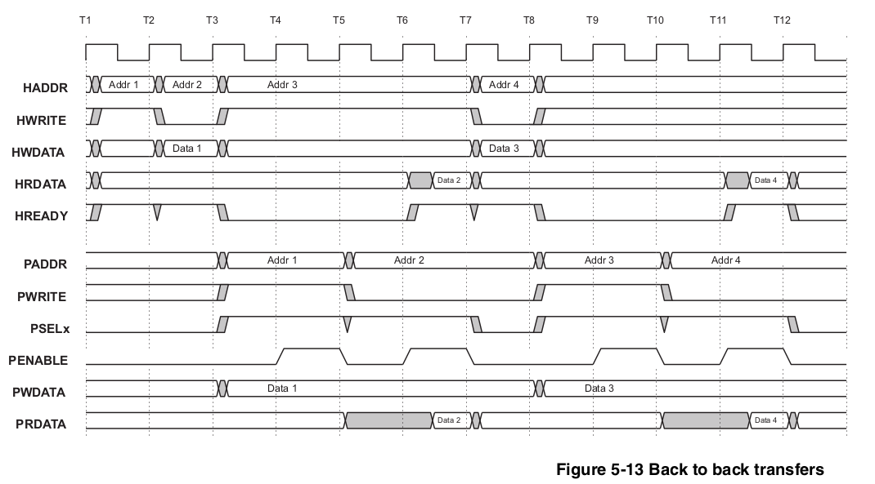
Read after Write transfer

Slide 14
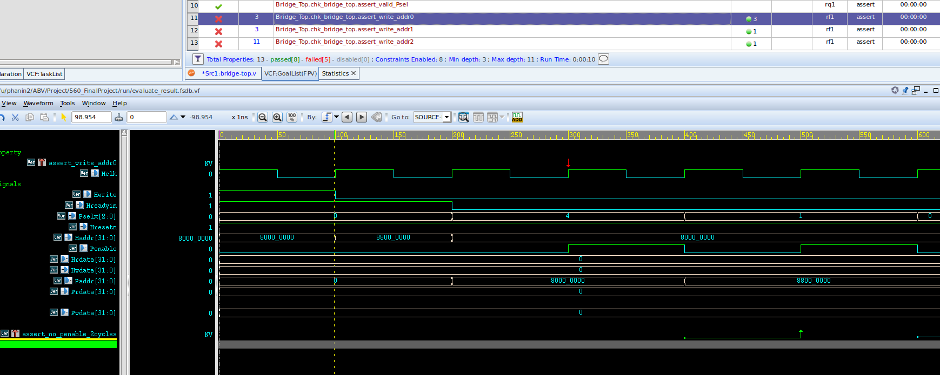
Pselx Issue

Slide 15
Next steps, and what to verify next.
So far, we have written assertions and assumptions verifying the basic functionality of the bridge, and we plan to write more thorough assertions and cover properties between now and the due date.
Issues we ran into:
We couldn’t find an RTL that clearly and completely implements the HBURST mechanism with multiple burst transactions. We decided to still write the (AIP) for those transactions, and if time permits, one or two of our teammates will write the HBURST code and the other one or two will write the assertions to verify it, but overall, we set out goal to “translate” the specs into properties (assertions and assumptions) and test as many of them as we can given the available RTLs, but there’s a chance we’ll have more properties than those implemented in the RTLs available, we’ll use ifdefs to isolate our additional assertions when running VC Formal.

